Slide 1
IDENTIFYING SOY BEAN & MAIZE HOTSPOTS IN EUROPE FOR 2016
PROJECT #2
START DATE: 03/27/17

Slide 2
PROBLEM FORMULATION
Objective
Background Knowledge
Data
Anticipated Hurdles
Methods
Analysis
Results
Interpretations
Discussion
Conclusion

Slide 3
OBJECTIVE
Find the spatial distribution (& hotspots)
Soybean & Maize
Europe
2016

Slide 4
BACKGROUND KNOWLEDGE
Literature
Soybean and Maize Classification Methods/Algorithms
Remote Sensing
NDVI for Soy in Europe
NDVI for Maize in Europe
Reference
JJ’s work on Brazil

Slide 5
DATA
MODIS data
Time Frame: 0-01-16 to 12-31-16
Resolution: 250 m (max.)
Website: reverb.echo.nasa.gov (EOSDIS)

Slide 6
ANTICIPATED HURDLES
Forests and Agriculture may have similar NDVI values/colors
Images with Clouds
Soy/Maize might have varying colors depending on their:
Age & Height i.e., function of time of the year
Location (maybe)

Slide 7
METHODS
Have land classification imagery to tease out just crops
Download NDVI Data and crop it for the AOI
Separate Soy and Maize from other crops
Get patterns from phenology
Identify NDVI values for the Soy and Maize

Slide 8
ANALYSIS
Convert continuous NDVI into grids with individual values
Then find the associated NDVI values for Soy and Maize
Match both
Finding the range of NDVI for Soy and Maize? Literature?
First - separate out areas which are just crops of interest
Either take a RGB and classify manually
Use an image that has (atleast) land classification
Separate out crops
Separate Soy and Maize from the crops

Slide 9
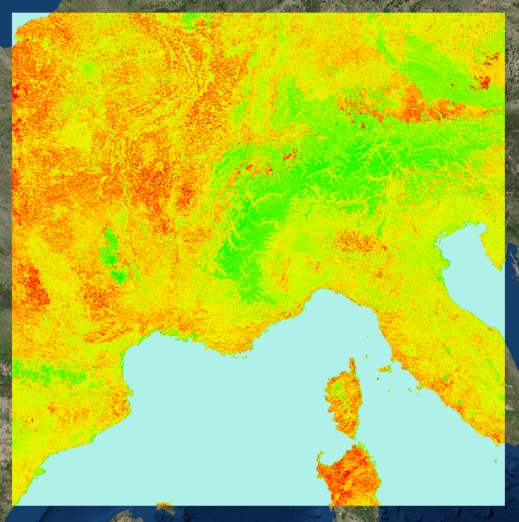
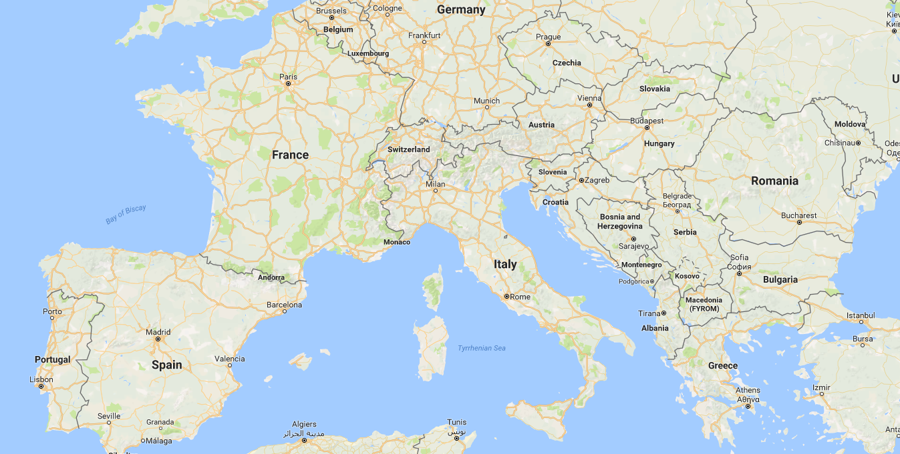
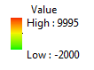
NDVI Images for 2016; Europe
Collected for 12 months – 250 m resolution
Southern portion encompassing France and Italy
WORK FLOW
PAGE #1

Slide 10
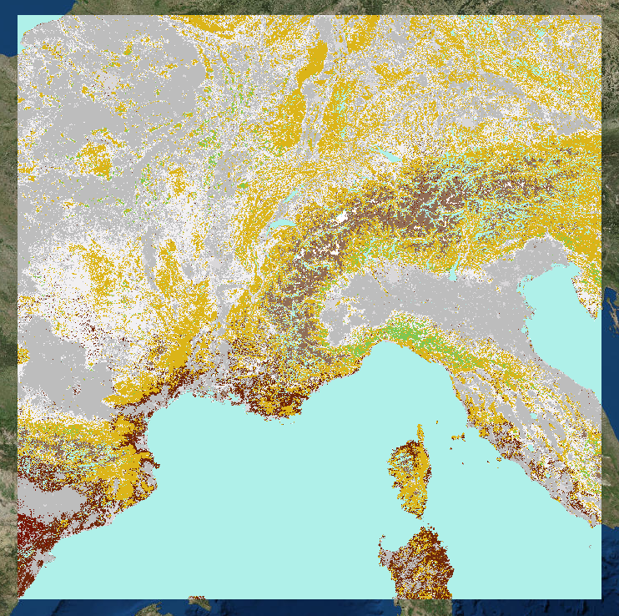
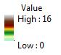
Landscape Classifications for Europe
Same area – 500 m resolution – for year 2013
maybe get for previous years too for comparison
Take Land Cover Type 1 – 16 classes
WORK FLOW
PAGE #2
https://lpdaac.usgs.gov/dataset_discovery/modis/modis_products_table/mcd12q1

Slide 11
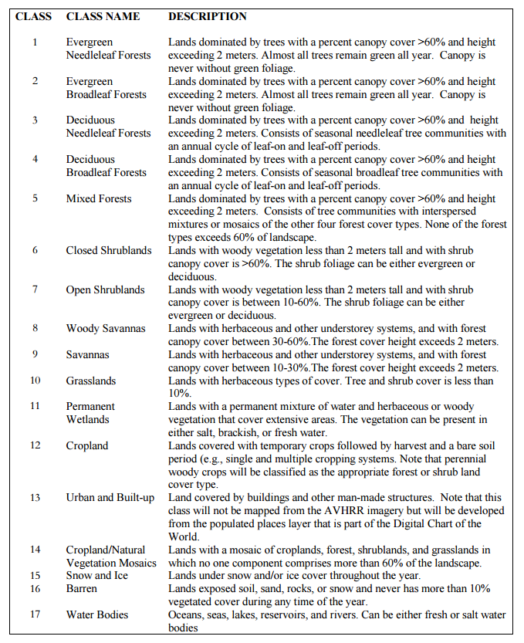
WORK FLOW
PAGE #
http://www.fao.org/forestry/4031-0b6287f13b0c2adb3352c5ded18e491fd.pdf - Page 19

Slide 12
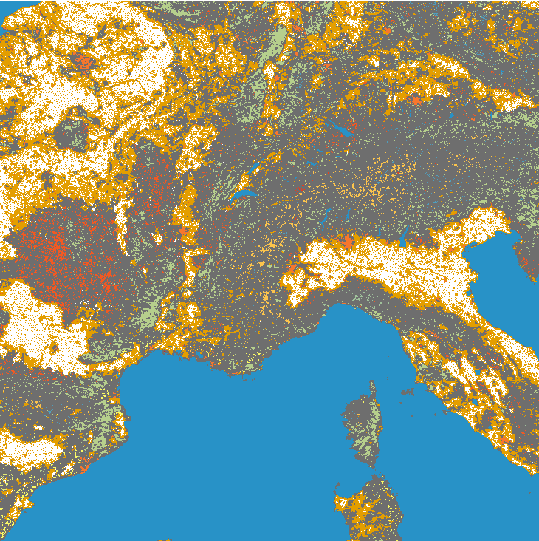
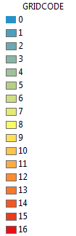
Conversion
Spatial Analyst -> Conversion Tools -> Raster to Poly
Classify based on Grid Codes
WORK FLOW
PAGE #

Slide 13
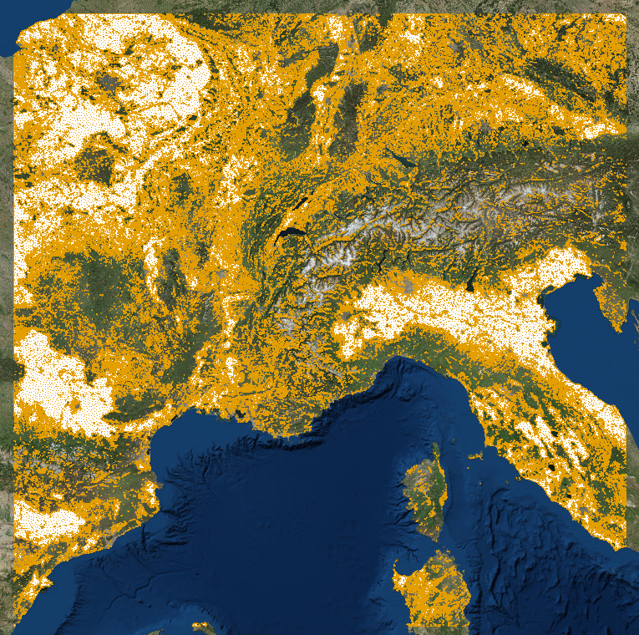
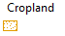
Land classification
Grid code: 12
Croplands
Later check for
Grid code: 14
Croplands/Natural Veg. Mosaics
WORK FLOW
PAGE #

Slide 14
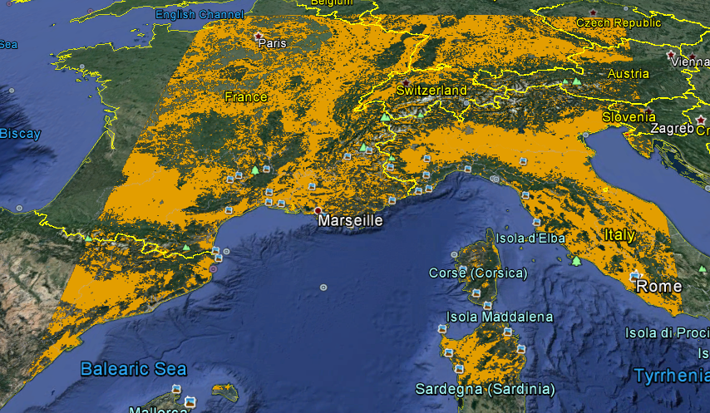
Southern Europe (SU)
Croplands (Class 12)
Year: 2013 (MODIS/reverb)
Does the classification makes sense?
Checking with Google Earth Imagery
(create KML and overlap)
Checking with MODIS normal Imagery
WORK FLOW
PAGE #

Slide 15
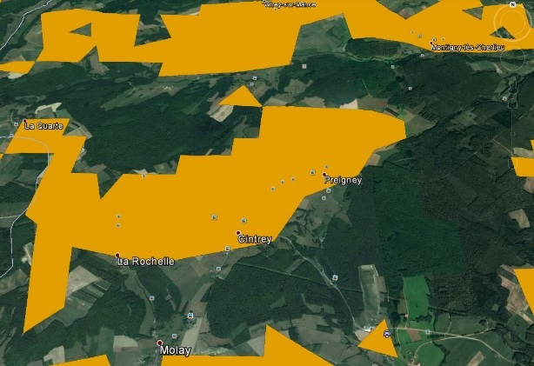
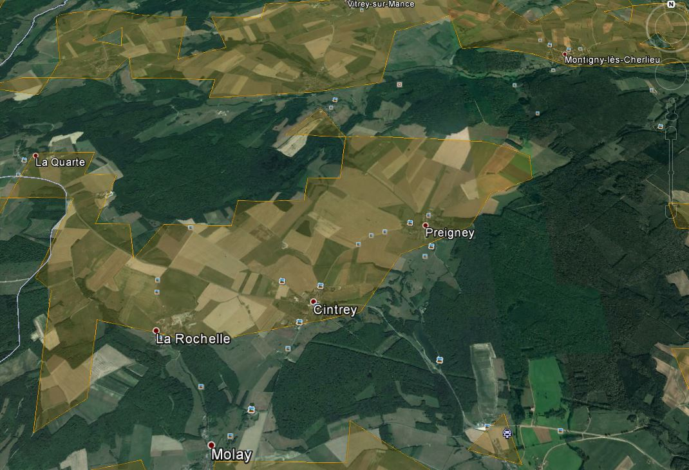
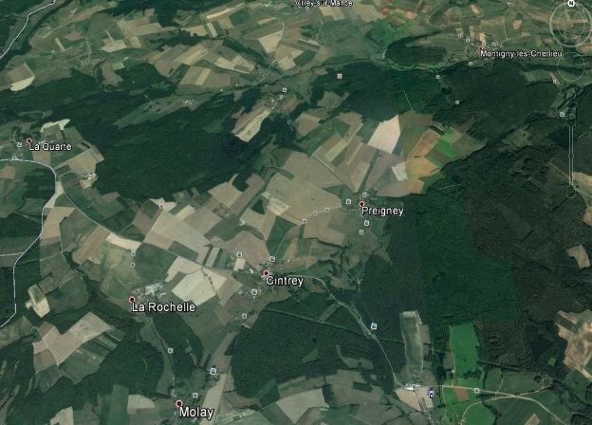
a) Sample Area with Opacity 100%
c) Sample Area with Opacity 30%
b) Sample Area with Opacity 0%
WORK FLOW
PAGE #

Slide 16
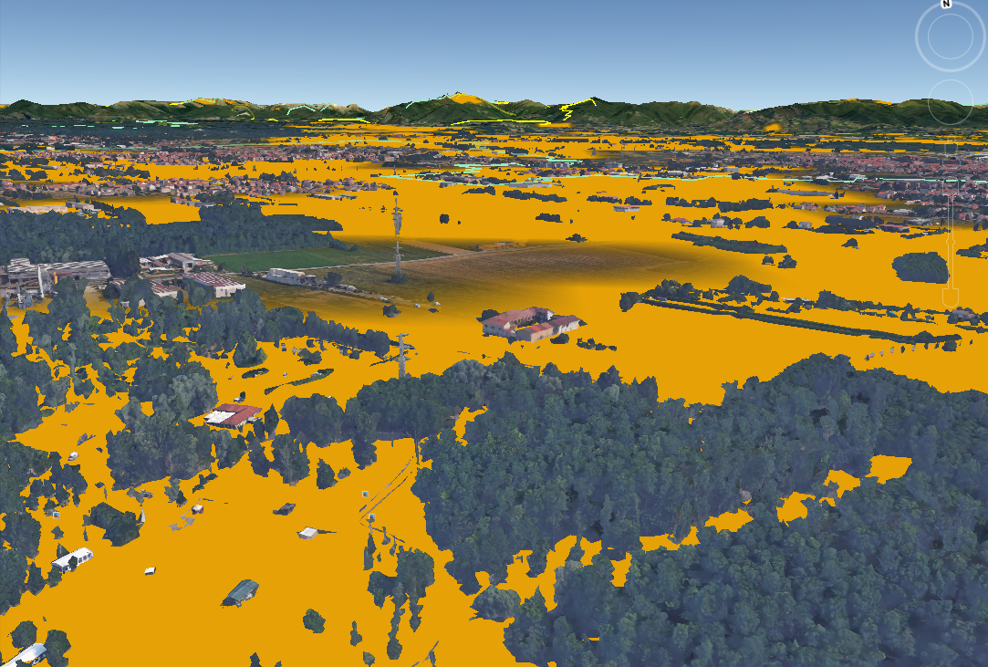
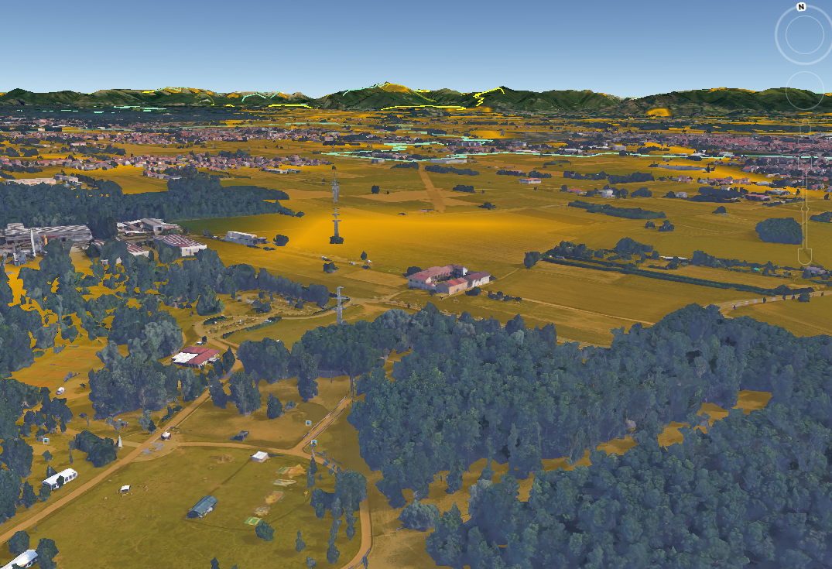
a) Sample Area with Opacity 100%
b) Sample Area with Opacity 50%
WORK FLOW
PAGE #

Slide 17
Find NDVI Associated with Soy and Maize
Sowing to Harvesting period for the crops
Append all the individual pieces (sections of Europe)
WORK FLOW
PAGE #

Slide 18
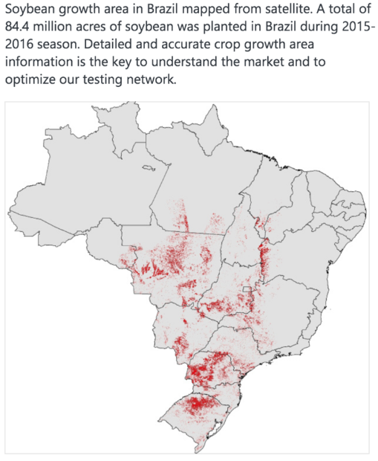
WORK FLOW
#REFERENCE
Yammer-Breeding~Monthly~Report~Group-JianjunGe

Slide 19
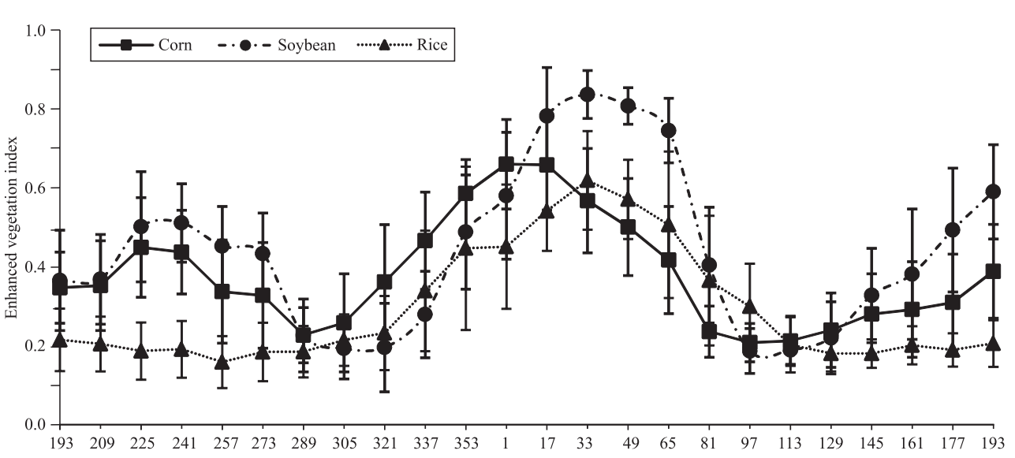
Sample reference: Soybean crop area estimation by Modis/EVI data
WORK FLOW
#SAMPLE

Slide 20
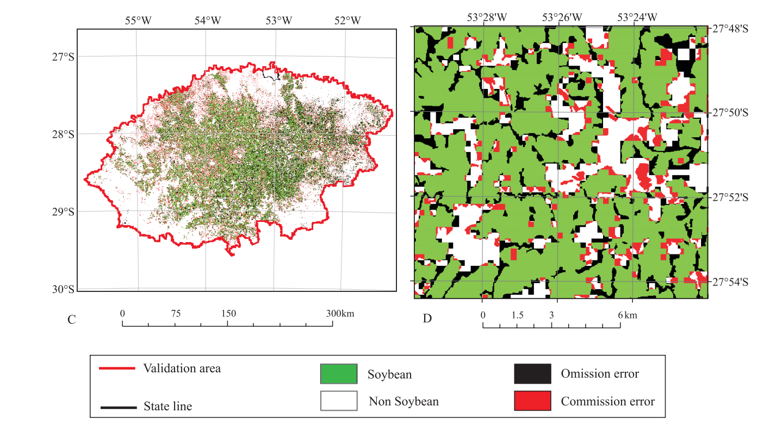
Sample reference: Soybean crop area estimation by Modis/EVI data
WORK FLOW
#SAMPLE

Slide 21
RESULTS

Slide 22
INTERPRETATION

Slide 23
DISCUSSION

Slide 24
CONCLUSION

Slide 25
THANK YOU
PROJECT #2
END DATE: 04/1*/17

